Slide 1
MARKETING ANALYTICS
SESSION 17:
PROMOTIONAL PRICING STRATEGIES
Professor Sonnier
Texas MSBA Program
Fall 2022

Slide 2

PRICING DECISIONS
Temporary Price Reductions

Slide 3
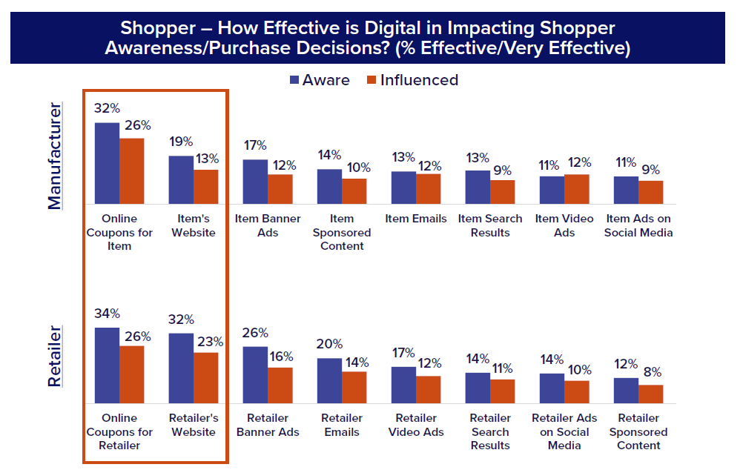
PRICE PROMOTIONS AS A MARKETING TOOL
Consumer Perspective on Digital Spending
Consumers view digital as coupon and information delivery vehicles

Slide 4
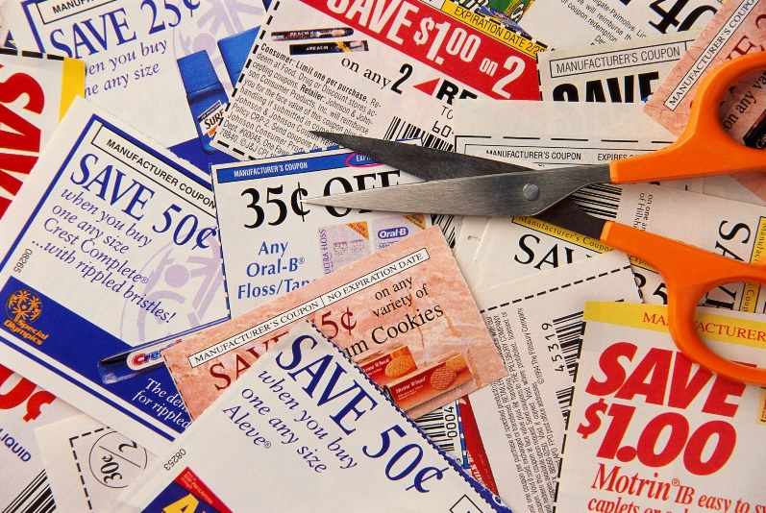
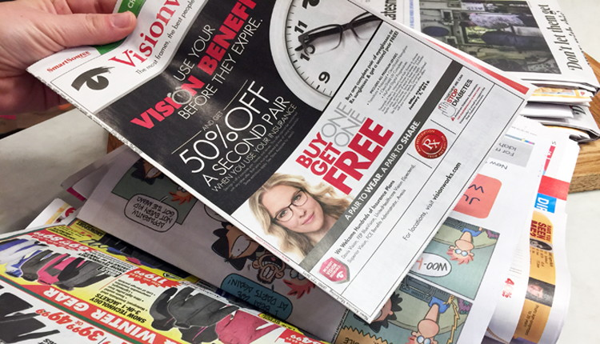
PRICE PROMOTIONS AS A MARKETING TOOL
Coupons

Slide 5
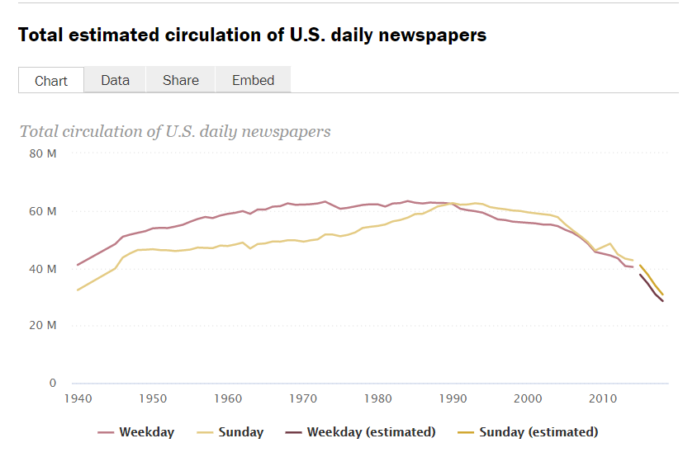
PRICE PROMOTIONS AS A MARKETING TOOL
Coupon Distribution
https://www.journalism.org/fact-sheet/newspapers/

Slide 6
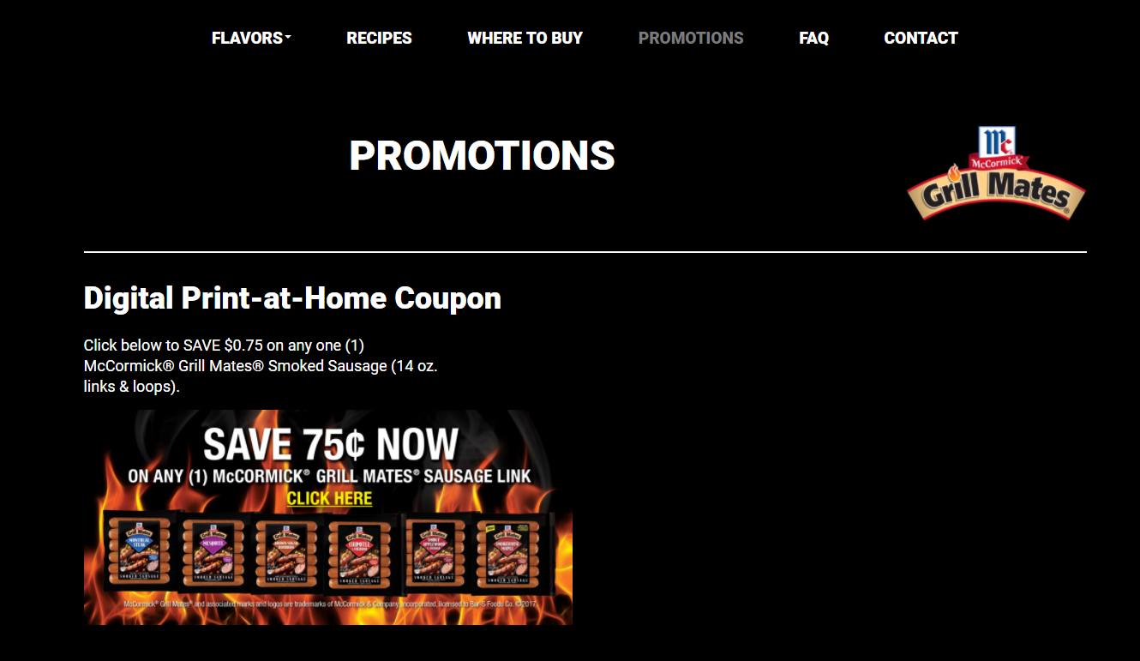
PRICE PROMOTIONS AS A MARKETING TOOL
Digital Coupons

Slide 7
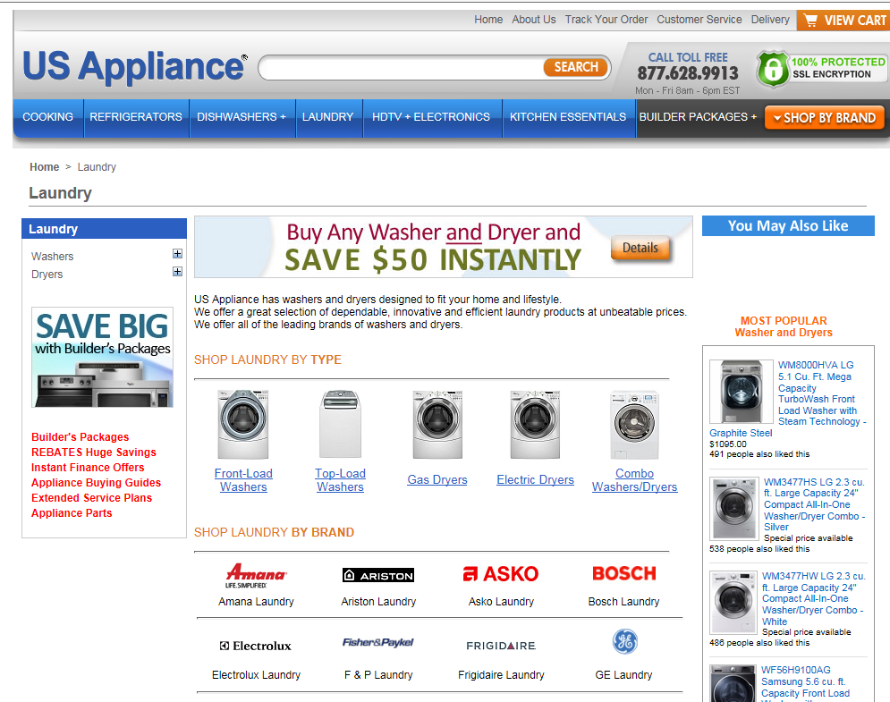
PRICE PROMOTIONS AS A MARKETING TOOL
Not Just CPG

Slide 8

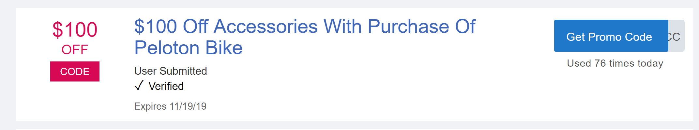
PRICE PROMOTIONS AS A MARKETING TOOL
Not Just CPG

Slide 9
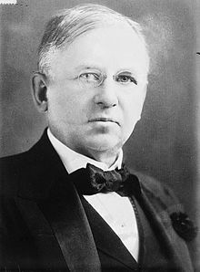
PRICE PROMOTIONS AS A MARKETING TOOL
Why?
“Half the money I spend on advertising is wasted. The trouble is I don’t know which half.”
---John Wanamaker

Slide 10
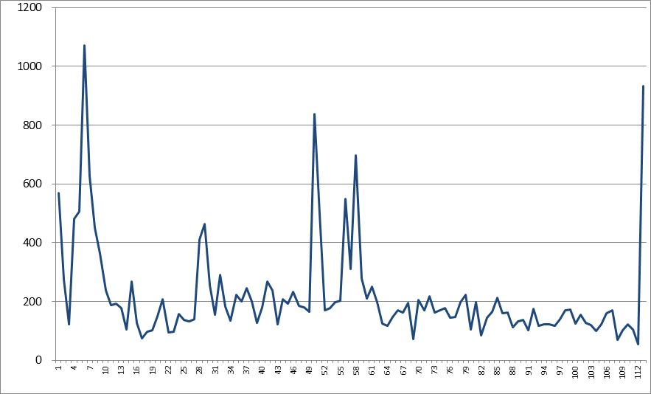
PRICE PROMOTIONS AS A MARKETING TOOL
Why?
Promotions almost always have a short run positive effect on sales
Promotion
Promotion
Promotion

Slide 11
PRICE PROMOTIONS AS A MARKETING TOOL
A Framework for The Consumer Decision Making Process
NEEDS TRIGGER
COGNITION
INFORMATION SEARCH
INFORMATION PROCESSING AND EVALUATION
AFFECT
PURCHASE DECISION
EXPERIENCE
POST PURCHASE EVALUATION

Slide 12
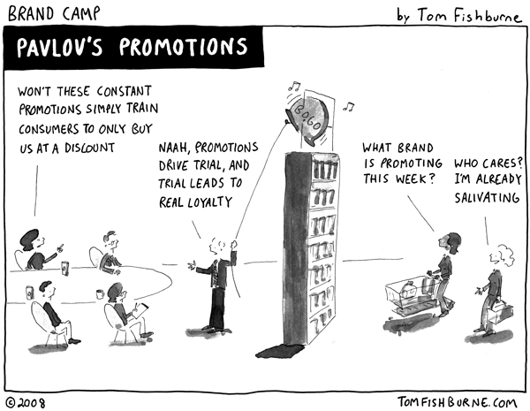
PRICE PROMOTIONS AS A MARKETING TOOL
Why Not?
Beliefs About Your Brand
Affect Towards Your Brand
Marketing Economics

Slide 13
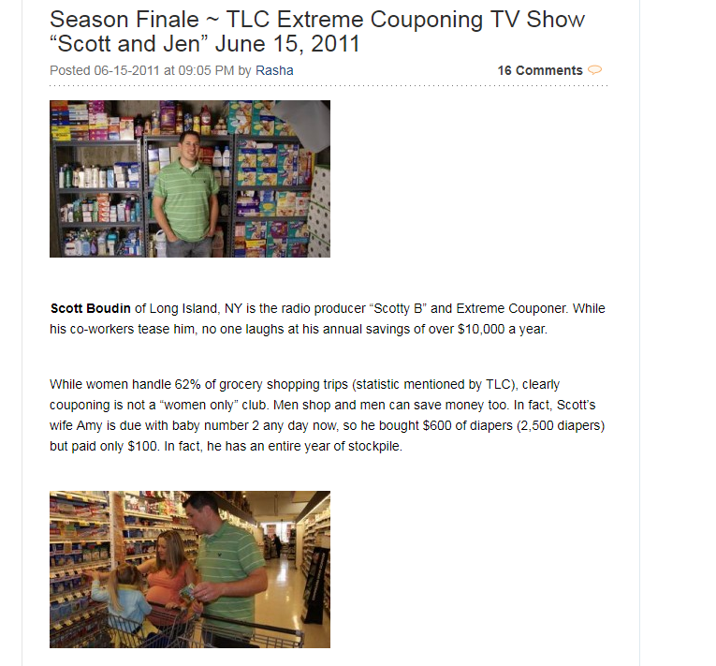
PRICE PROMOTIONS AS A MARKETING TOOL
Coupons

Slide 14
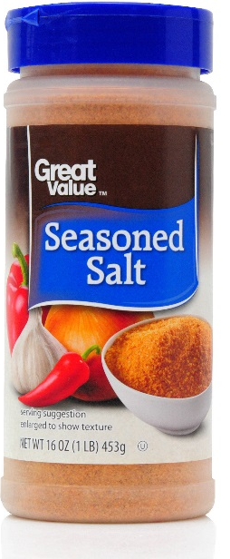
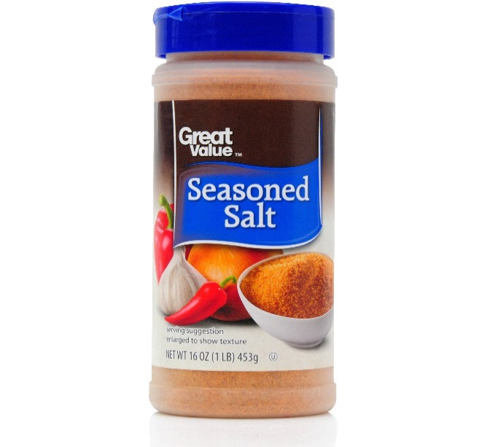
PRICE PROMOTIONS AS A MARKETING TOOL
Salt Life
Sonnier

Slide 15


PRICE PROMOTIONS AS A MARKETING TOOL
Assessing the Profit Impact on a Manufacturer
Sonnier
Sonnier Seasoned Salt is the leading national brand of seasoned salt in the U.S. market
The Sonnier brand manager is considering options for consumer promotions for the month of January 2019.
The product is sold to retailers in cases of 24 16 oz. containers
The regular gross margin the company makes on each case is $37.20 or $1.55 per 16 oz. container (after accounting for trade promotional spending).

Slide 16
PRICE PROMOTIONS AS A MARKETING TOOL
Assessing the Profit Impact on a Manufacturer
Consumer promotions have historically been executed as a free-standing coupon drop in various local Sunday newspapers around the country.
In the face of falling newspaper subscription rates Sonnier Salt has distributed coupons via its website since 2008. Consumers simply download and print the coupon and offer it for redemption at participating retailers. By late 2009, Sonnier Salt realized negligible download and redemption rates and thus in 2010 began spending on display advertising to drive traffic to the coupon webpage. Traffic on the websites served by the ad network largely consist of consumers who do not subscribe to newspapers and would otherwise be missed.
Cost details for Jan 2019 offline and online spend are as follows

Slide 17
PRICE PROMOTIONS AS A MARKETING TOOL
Jan 2019 Coupon: Newspaper
The plan is to distribute 2 million coupons of $1.00 face value in two of the five Sundays in January 2019 (Jan 13 and Jan 27) via a free standing insert into local market newspapers nationwide
Each coupon is valid towards $1.00 off the retail purchase price of one 16 oz. container of Sonnier Seasoned Salt
Based on past research, the manager knows that on average 10% of the coupons are redeemed
Printing and distribution costs for the coupons are $15 per thousand coupons
Coupon processing costs are 10 cents per redeemed coupon

Slide 18
PRICE PROMOTIONS AS A MARKETING TOOL
Jan 2019 Coupon: Display Ad Network
Sonnier’s will place display ads on a network of websites that sell display ads on a cost-per-impression (CPM) basis. The ads are designed to drive traffic to the webpage with the coupon where consumers can download the coupon for redemption. The average cost-per-thousand impressions is $0.60.
As with the newspaper each coupon is valid towards $1.00 off the retail purchase price of one 16 oz. container of Sonnier Seasoned Salt. Sonnier’s also pays a $0.10 processing fee for online coupons redeemed by consumers.
The managerial goal for the display campaign is to generate 100MM impressions for the month. Historically impressions generate a click rate of 4% for a total of 4MM site visits for the month
Again, based on past experience the manager expects the number of redeemed website coupons are 10% of the total site visits resulting from the display campaign. Organic and direct traffic is negligible and can be ignored for our purposes. The company also does not spend on paid search ads on Google.

Slide 19
PRICE PROMOTIONS AS A MARKETING TOOL
Assessing the Profit Impact on a Manufacturer
The manager has decided to freeze trade promotions so that all amounts will be identical by prior year’s month.
(i.e. Jan 18 = Jan 19, Feb 18 = Feb 19).
The manager is considering whether to offer a consumer promotion during the month of January.
Things we need to know:
What is the cost of this promotion?
What are the sales (in cases) required to break-even on this promotion?
How will the consumer promotion impact profits?
Should the manager proceed with the promotion?
NOTE: Here we will consider total cost and profitability combining spend on newspaper and web coupon distribution and redemption. We can later return to the relative cost and effectiveness of each spend.

Slide 20
PRICE PROMOTIONS AS A MARKETING TOOL
Sonnier Seasoned Salt: Newspaper Coupon Costs
2MM coupons on each of 2 Sundays = 4MM coupons will be printed and distributed
Printing and distribution costs are 4,000 x $15 = $60,000
400,000 (10% of total) coupons will be redeemed
Processing costs are 400,000 x $0.10 = $40,000
Payment to retailer is $400,000 (400,000 coupons at $1 face value)
Total costs are $500,000

Slide 21
PRICE PROMOTIONS AS A MARKETING TOOL
Sonnier Seasoned Salt: Website Coupon Costs
100MM pages views with a 4% click rate yields 4,000,000 site visits
At a cost per 1000 impressions of $0.6 this is $60,000
Printing is done by the consumer*
400,000 coupons are downloaded and redeemed (10% of the site visits result in download and redemption)
Processing costs are 400,000 x $0.10 = $40,000
Payment to retailer is $400,000 (400,000 coupons at $1 face value)
Total costs are $500,000
*NOTE: We allow one printing per IP address. However, this can be circumvented by using multiple computers.

Slide 22
PRICE PROMOTIONS AS A MARKETING TOOL
Sonnier Seasoned Salt: Promotion Cost Summary
For Newspaper coupons, the costs are as follows:
Printing and distribution costs are $60,000
Processing costs are $40,000
Payment to retailer is $400,000
For Website coupons the costs are as follows:
Payment to the network is $60,000
Processing costs are $40,000
Payment to retailer is $400,000

Slide 23
PRICE PROMOTIONS AS A MARKETING TOOL
Sonnier Seasoned Salt: Simple Breakeven Economics
Even if a single coupon is not redeemed, Sonnier’s will spend $120K
Sales of 266,667 units (11,111 cases) would cover the promotional costs of $120K
Does this imply that sales beyond 266,667 units are profitable?
We need to understand the concept of baseline and incremental sales
NOTE: A unit here is a 16 oz. container on which the normal margin is $1.55.

Slide 24
PRICE PROMOTIONS AS A MARKETING TOOL
Sonnier Seasoned Salt: Simple Breakeven Economics
Baseline Sales
Sales expected to occur absent any promotional efforts
Incremental Sales
Sales attributable to promotional efforts

Slide 25
PRICE PROMOTIONS AS A MARKETING TOOL
Sonnier Seasoned Salt: Simple Breakeven Economics
Even if a single coupon is not redeemed, Sonnier’s will spend $120K
Historical data suggests 800,000 coupons will be redeemed
Imagine that of these 800,000 units sold
266,667 are truly incremental (i.e., would not have occurred otherwise)
What about the other 533,333 units?
NOTE: A unit here is a 16 oz. container on which the normal margin is $1.55.

Slide 26
PRICE PROMOTIONS AS A MARKETING TOOL
Sonnier Seasoned Salt: Simple Breakeven Economics
If the remaining 533,333 units would have been sold at the regular price then each unit represents a $1.10 loss of margin
This implies the promotions results in a loss of $466,667
But we do not know the mix of incremental and baseline sales
Let’s try to understand the boundary conditions (i.e., all/none incremental)
For each boundary condition what is the total and per unit margin?
NOTE: A unit here is a 16 oz. container on which the normal margin is $1.55.

Slide 27
PRICE PROMOTIONS AS A MARKETING TOOL
Sonnier Seasoned Salt: Less Simple Breakeven Economics
Margin per unit after considering printing costs is $0.30 if all incremental

Slide 28
PRICE PROMOTIONS AS A MARKETING TOOL
Sonnier Seasoned Salt: Less Simple Breakeven Economics
Margin loss if none are incremental is $1.25
We can now find the proportion of incremental sales (p) required to break even on the promotion by solving the following for p

Slide 29
PRICE PROMOTIONS AS A MARKETING TOOL
Sonnier Seasoned Salt: Less Simple Breakeven Economics

Slide 30
PRICE PROMOTIONS AS A MARKETING TOOL
Assessing the Profit Impact on a Manufacturer
The manager has data from 2010-2018 in which the brand has offered different consumer and trade promotions and seen various levels of sales.
Sonnier

Slide 31
PRICE PROMOTIONS AS A MARKETING TOOL
Assessing the Profit Impact on a Manufacturer
Consumer Promotion spend in Jan 19 will be $800,000
Since each coupon is $1 this is the number of redeemed coupons
Sales (in units) may be greater than 800K. Why?
What is the incremental sales given a change in promotion spending?
Other factors affecting sales?

Slide 32
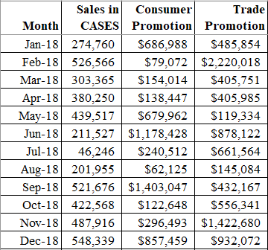
PRICE PROMOTIONS AS A MARKETING TOOL
Assessing the Profit Impact on a Manufacturer
What to use as baseline?
Jan-18
Dec-18
Something else?
Ideally, I would like to predict Jan-19 sales with and without the $800,000 consumer promotion spend

Slide 33
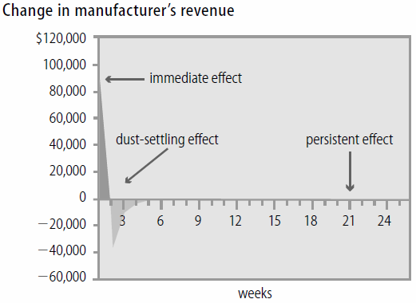
PRICE PROMOTIONS AS A MARKETING TOOL
Who Benefits, When, and How?
Revenues after promotion dip below the baseline
Can I account for this phenomenon in my model?
If so, does this suggest a way to account for baseline and incremental sales?
SOURCE: Who Benefits from Price Promotions?

Slide 34
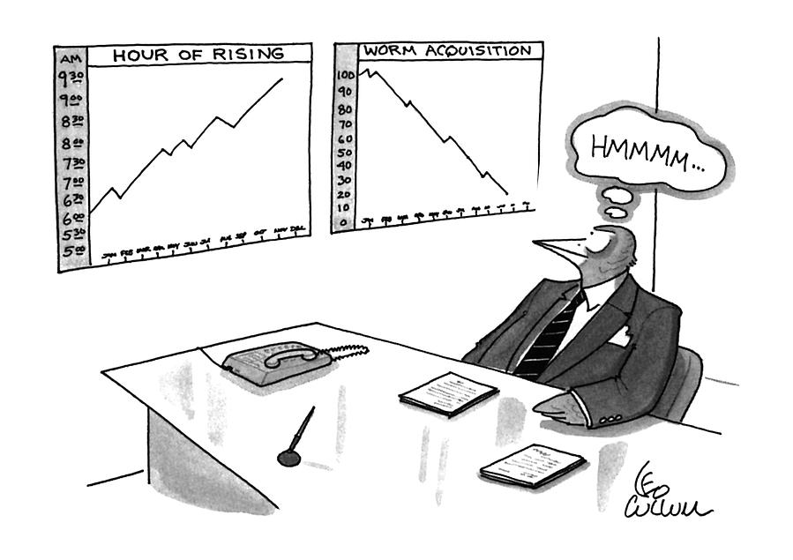
PRICE PROMOTIONS AS A MARKETING TOOL
Using Response Models to Study Promotion Decisions

Slide 35
PRICE PROMOTIONS AS A MARKETING TOOL
Using Response Models to Study Promotion Decisions
Use the data to build a regression model of sales (in cases) as a function of consumer and trade promotional spending
Let’s start with a simple model of sales as a function of consumer and trade promotional spending (at the same time)

Slide 36
PRICE PROMOTIONS AS A MARKETING TOOL
Sonnier Seasoned Salt
Using the data in the “Data for Simple Model” tab estimate a model with sales as the “y” variable and consumer and trade promotions as the two “X” variables
What do you conclude about the effect of consumer and trade promotions?

Slide 37
PRICE PROMOTIONS AS A MARKETING TOOL
Sonnier Seasoned Salt
What other features can we add to the model?
Lagged sales effects?
Seasonality?
Trend effects?

Slide 38
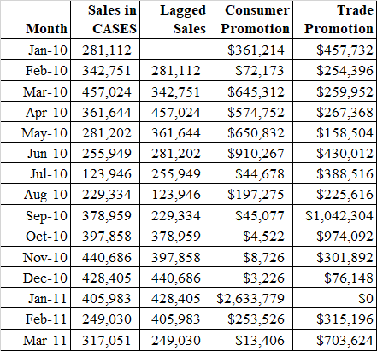
PRICE PROMOTIONS AS A MARKETING TOOL
Sonnier Seasoned Salt
Using the data in the “Data for Lagged Sales Model” tab add “Lagged Sales” as an X variable to your model
What do you conclude about the effect of consumer and trade promotions?
What is the effect of lagged sales?

Slide 39
PRICE PROMOTIONS AS A MARKETING TOOL
Sonnier Seasoned Salt
Lagged Sales are positive and significant

Slide 40
PRICE PROMOTIONS AS A MARKETING TOOL
Sonnier Seasoned Salt
How can we capture seasonality and trend effects?

Slide 41
PRICE PROMOTIONS AS A MARKETING TOOL
Sonnier Seasoned Salt
Seasonality captured with dummy variables for each month (Jan treated as base)
Trend variable captures any potential sales growth over time
Use the data in the Trend and Seaonal tab to estimate a sales model with these X variables

Slide 42
PRICE PROMOTIONS AS A MARKETING TOOL
Sonnier Seasoned Salt

Slide 43
PRICE PROMOTIONS AS A MARKETING TOOL
Sonnier Seasoned Salt
How to capture this effect in the model?
SOURCE: Who Benefits from Price Promotions?

Slide 44
PRICE PROMOTIONS AS A MARKETING TOOL
Sonnier Seasoned Salt
How to capture this effect in the model?
How should I interpret coefficients on lagged promotional spending?
SOURCE: Who Benefits from Price Promotions?

Slide 45
PRICE PROMOTIONS AS A MARKETING TOOL
Sonnier Seasoned Salt
Lagged promotion variables capture effect of previous month promotion
Used the data in the “Lagged Promo” tab to estimate a model with these X variables

Slide 46
PRICE PROMOTIONS AS A MARKETING TOOL
Sonnier Seasoned Salt
I will drop lagged sales and lagged trade promotions from final model
Data in “Final Model” tab

Slide 47
PRICE PROMOTIONS AS A MARKETING TOOL
Sonnier Seasoned Salt: Final Model
Now use the model estimates to predict sales in cases for Jan 2019

Slide 48
PRICE PROMOTIONS AS A MARKETING TOOL
Sonnier Seasoned Salt: Final Model
Use your model coefficients from the final model
Plug in the X variables for the scenario
Compute expected sales

Slide 49
PRICE PROMOTIONS AS A MARKETING TOOL
Sonnier Seasoned Salt: Expected Sales for JAN 2019
Sales improve by 65,954 cases
NOTE: Lag C Promotion is the value of Consumer Promotions from December 2018. Trade Promotions are set to 2018 levels thus the value of Trade Promotion for Jan 2019 is the Jan 2018 level.
Am I done?

Slide 50
PRICE PROMOTIONS AS A MARKETING TOOL
Sonnier Seasoned Salt: Expected Sales for FEB 2019
NOTE: With no Jan promotion the value for Lag C. Promotion is 0. With Jan Promotion it is 800K. Trade Promotions are set to 2018 levels thus the value of Trade Promotion for Feb 2019 is the Feb 2018 level.
Sales decline by 36,350 cases
Jan-Feb sales increase by 65,954 – 36,350 = 29,604 cases

Slide 51
PRICE PROMOTIONS AS A MARKETING TOOL
Sonnier Seasoned Salt: Promotion Profitability (Quickly)
Total costs are $1,000,000
Sales increase is 29,604 cases adjusted for the Feb sales dip
At $37.20 per case (before accounting for promotional costs), this would be $1,101,261 in contribution
Adjusted for $1,000,000 cost of promotional spending Sonnier is expected to net $101,261 from the Jan consumer promotion

Slide 52
PRICE PROMOTIONS AS A MARKETING TOOL
Sonnier Seasoned Salt: Promotion Profitability (More Detail)
JAN: Sales improve by 65,954 cases or 1,582,896 units (24 units per case)
800,000 of these units had at margin of $0.45 ($1.55 less coupon redemption and processing costs) while the remaining 782,896 had at margin of $1.55
Total contribution is $360,000 plus $1,213,489 for a total of $1,573,489
FEB: Sales decline by 36,350 cases or 872,405 units (24 units per case)
Each unit represents a loss of $1.55 in margin
Total loss is $1,352,228
Net gain in contribution is $1,573,489 minus $1,352,228 = $221,261
Less ad network and newpaper costs of $120,000 gives final contribution of $101,261

Slide 53
PRICE PROMOTIONS AS A MARKETING TOOL
Some Final Thoughts
If purchase cycle dynamics are important (i.e., forward buying and storage) accounting for post-promotional dips is crucially important in assessing promotional profitability
We can use lags of promotional spending to account for past promotional effects
What other factors might a manager consider?
Statistical Factors
Strategic Factors

